Slide 1

Department of Computer Engineering
Sequential Logic Design – Sequence Detector
1

Slide 2
Points covered
Department of Computer Engineering
Introduction
Sequence Detector truth table
2

Slide 3
Department Vision & Mission
Department of Computer Engineering
Vision
Achieve academic excellence through education in computing, to create intellectual manpower to explore professional, higher educational and social opportunities.
Mission
To impart learning by educating students with conceptual knowledge and hands on practices using modern tools, FOSS technologies and competency skills there by igniting the young minds for innovative thinking, professional expertise and research.

Slide 4
Department of Computer Engineering
J K Flip Flop
JK truth table
JK excitation table
J | K | Qn+1
0 | 0 | Qn
0 | 1 | 0
1 | 0 | 1
1 | 1 | Qn’
Qn | Qn+1 | J | K
0 | 0 | 0 | X
0 | 1 | 1 | X
1 | 0 | X | 1
1 | 1 | X | 0

Slide 5
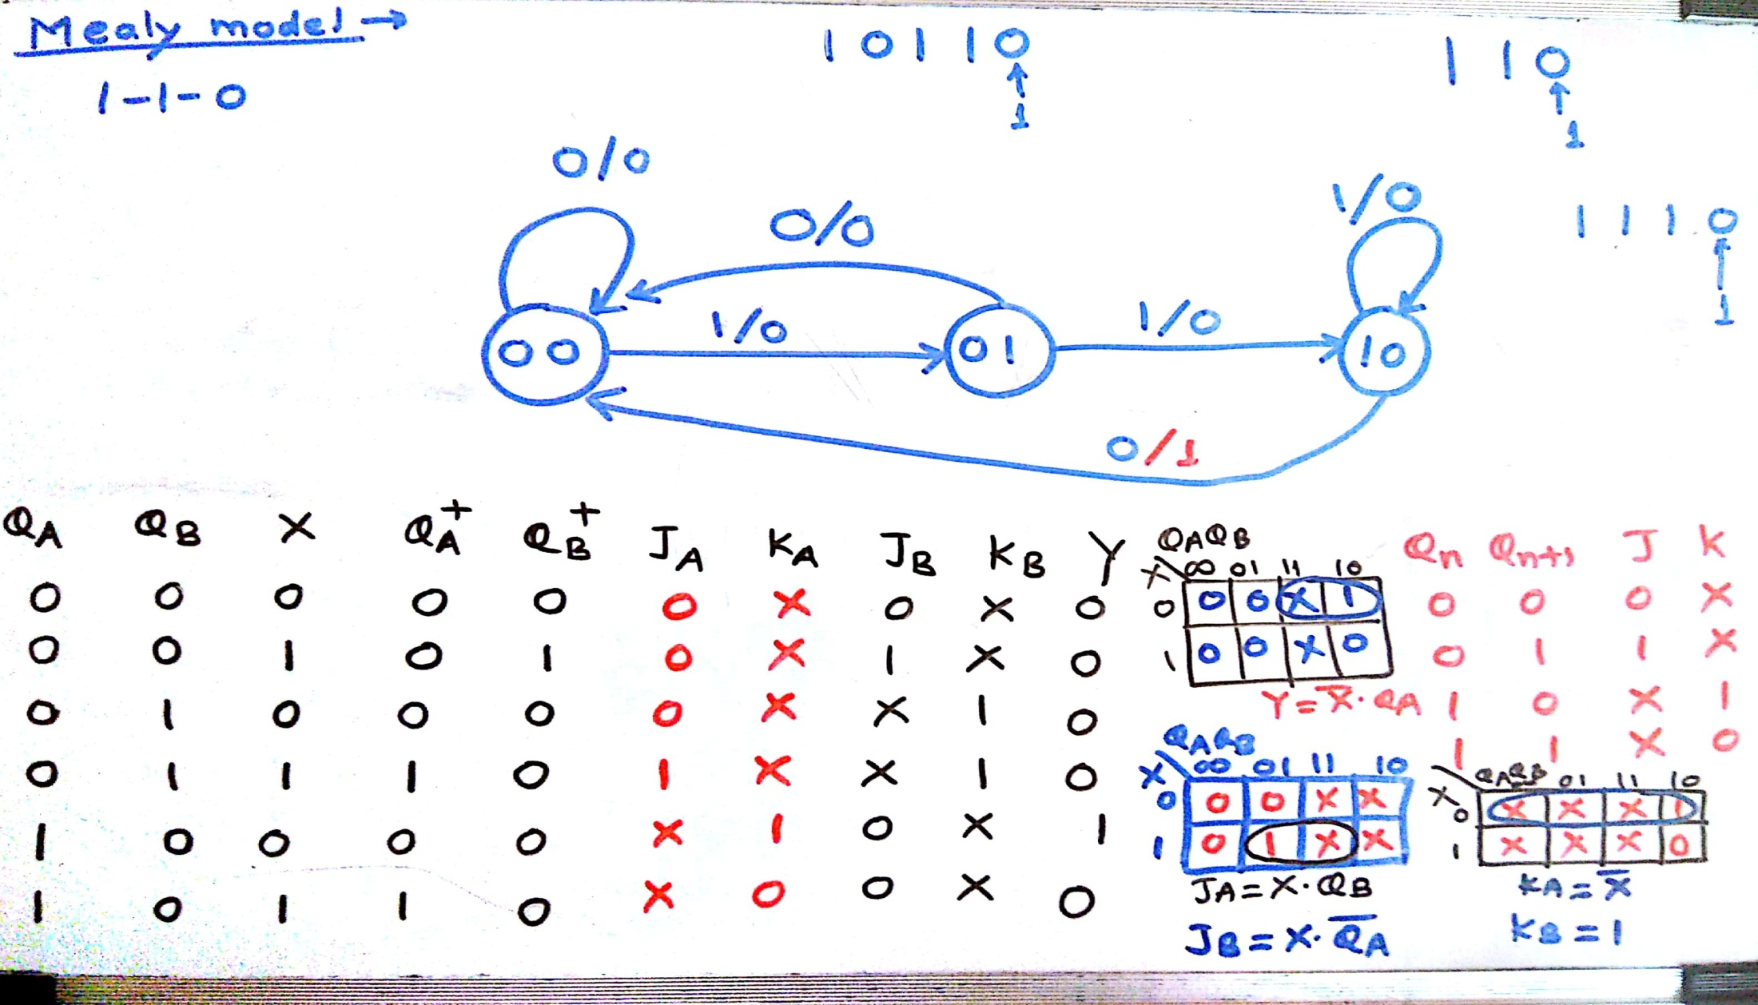
Design & implement Sequence detector using MS JK flip-flop
Department of Computer Engineering

Slide 6
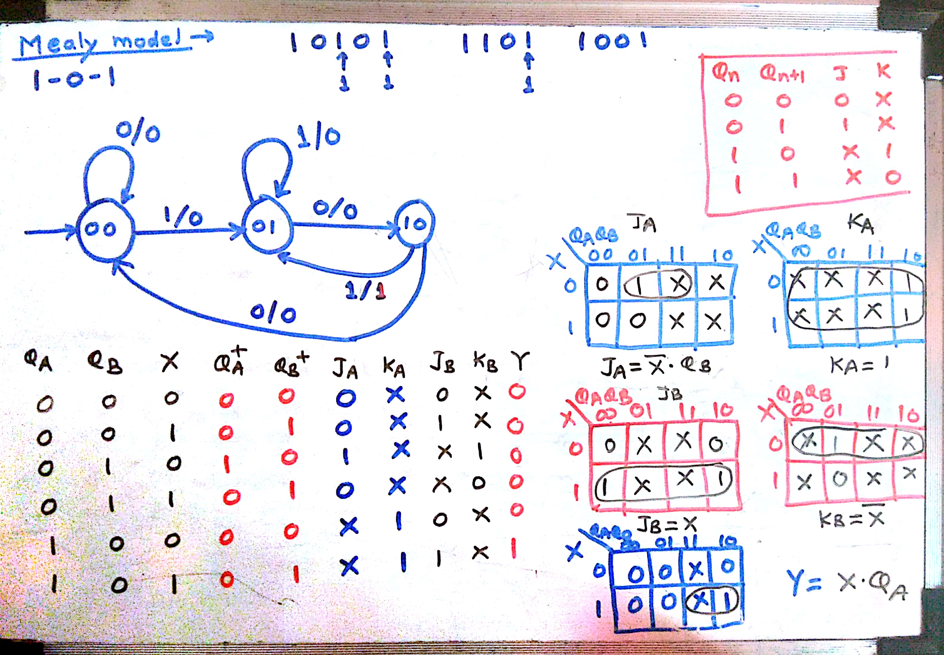
Design & implement Sequence detector using MS JK flip-flop
Department of Computer Engineering

Slide 7
The specified input sequence can be detected using a sequential machine called as Sequence Detector.
Output of the circuit goes High when a prescribed input sequence is detected.
Example: Design and implement Sequence detector for sequence 1010

Slide 8
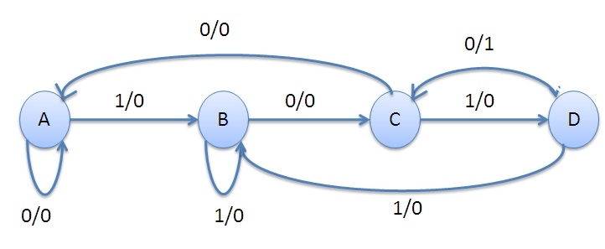
State Diagram
sequence: 1 0 1 0
State:
A – Initial State
B – 1 is seen
C – 10 is seen
D – 101 is seen

Slide 9
PRESENT STATE | NEXT STATE OUTPUT
 | X=0 | X=1
A | A , 0 | B , 0
B | C , 0 | B , 0
C | A, 0 | D, 0
D | C , 1 | B, 0

Slide 10
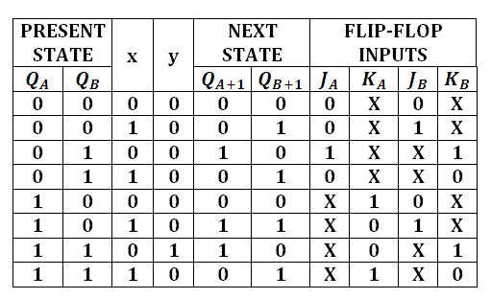

Slide 11
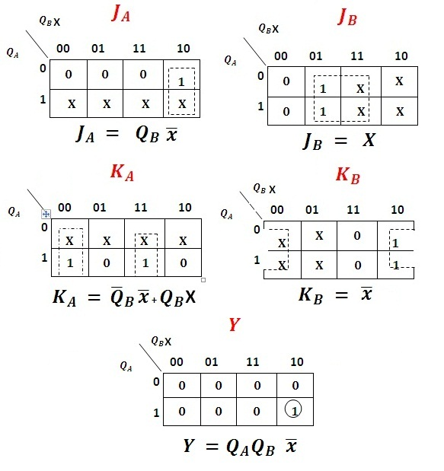
K-Map & Simplification:

Slide 12
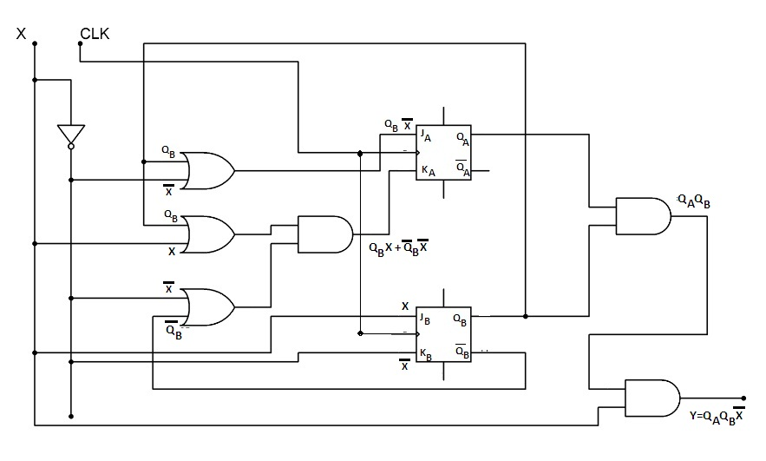
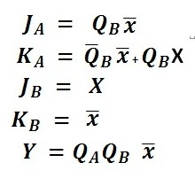
Sequence Detector Circuit Diagram:
Input Expressions
for Flip-Flop

Slide 13
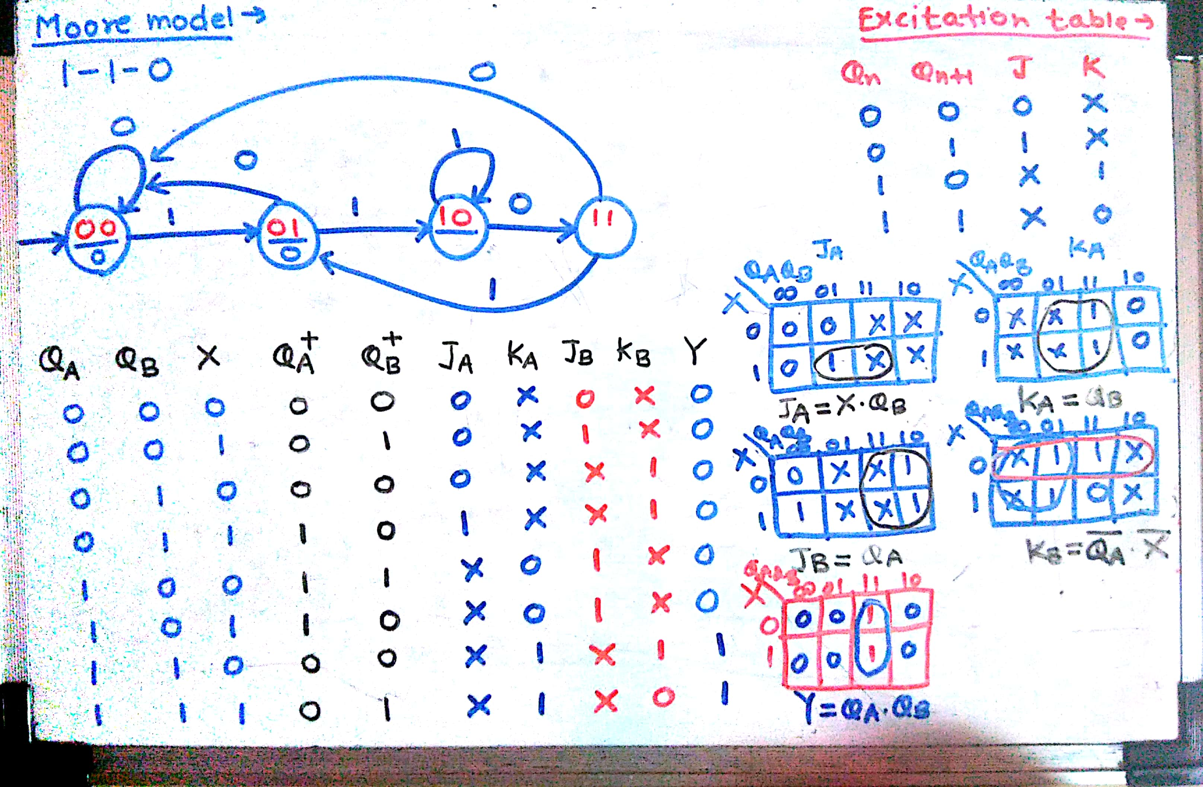

Slide 14
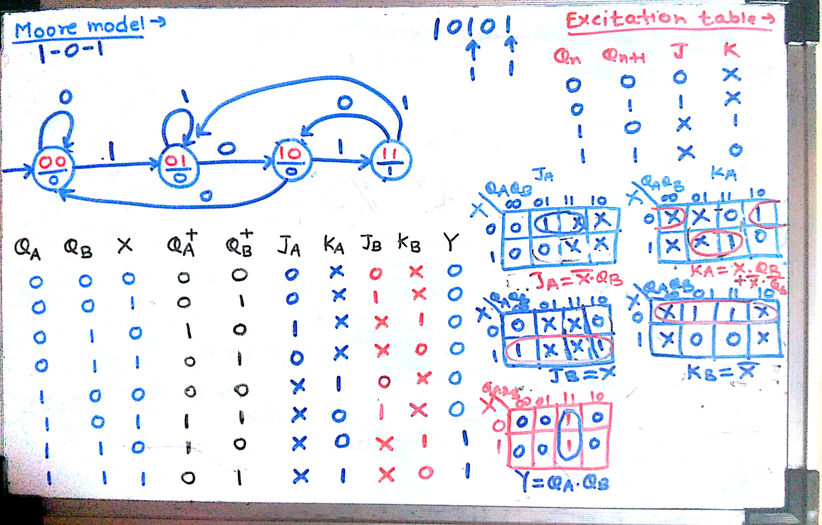

Slide 15
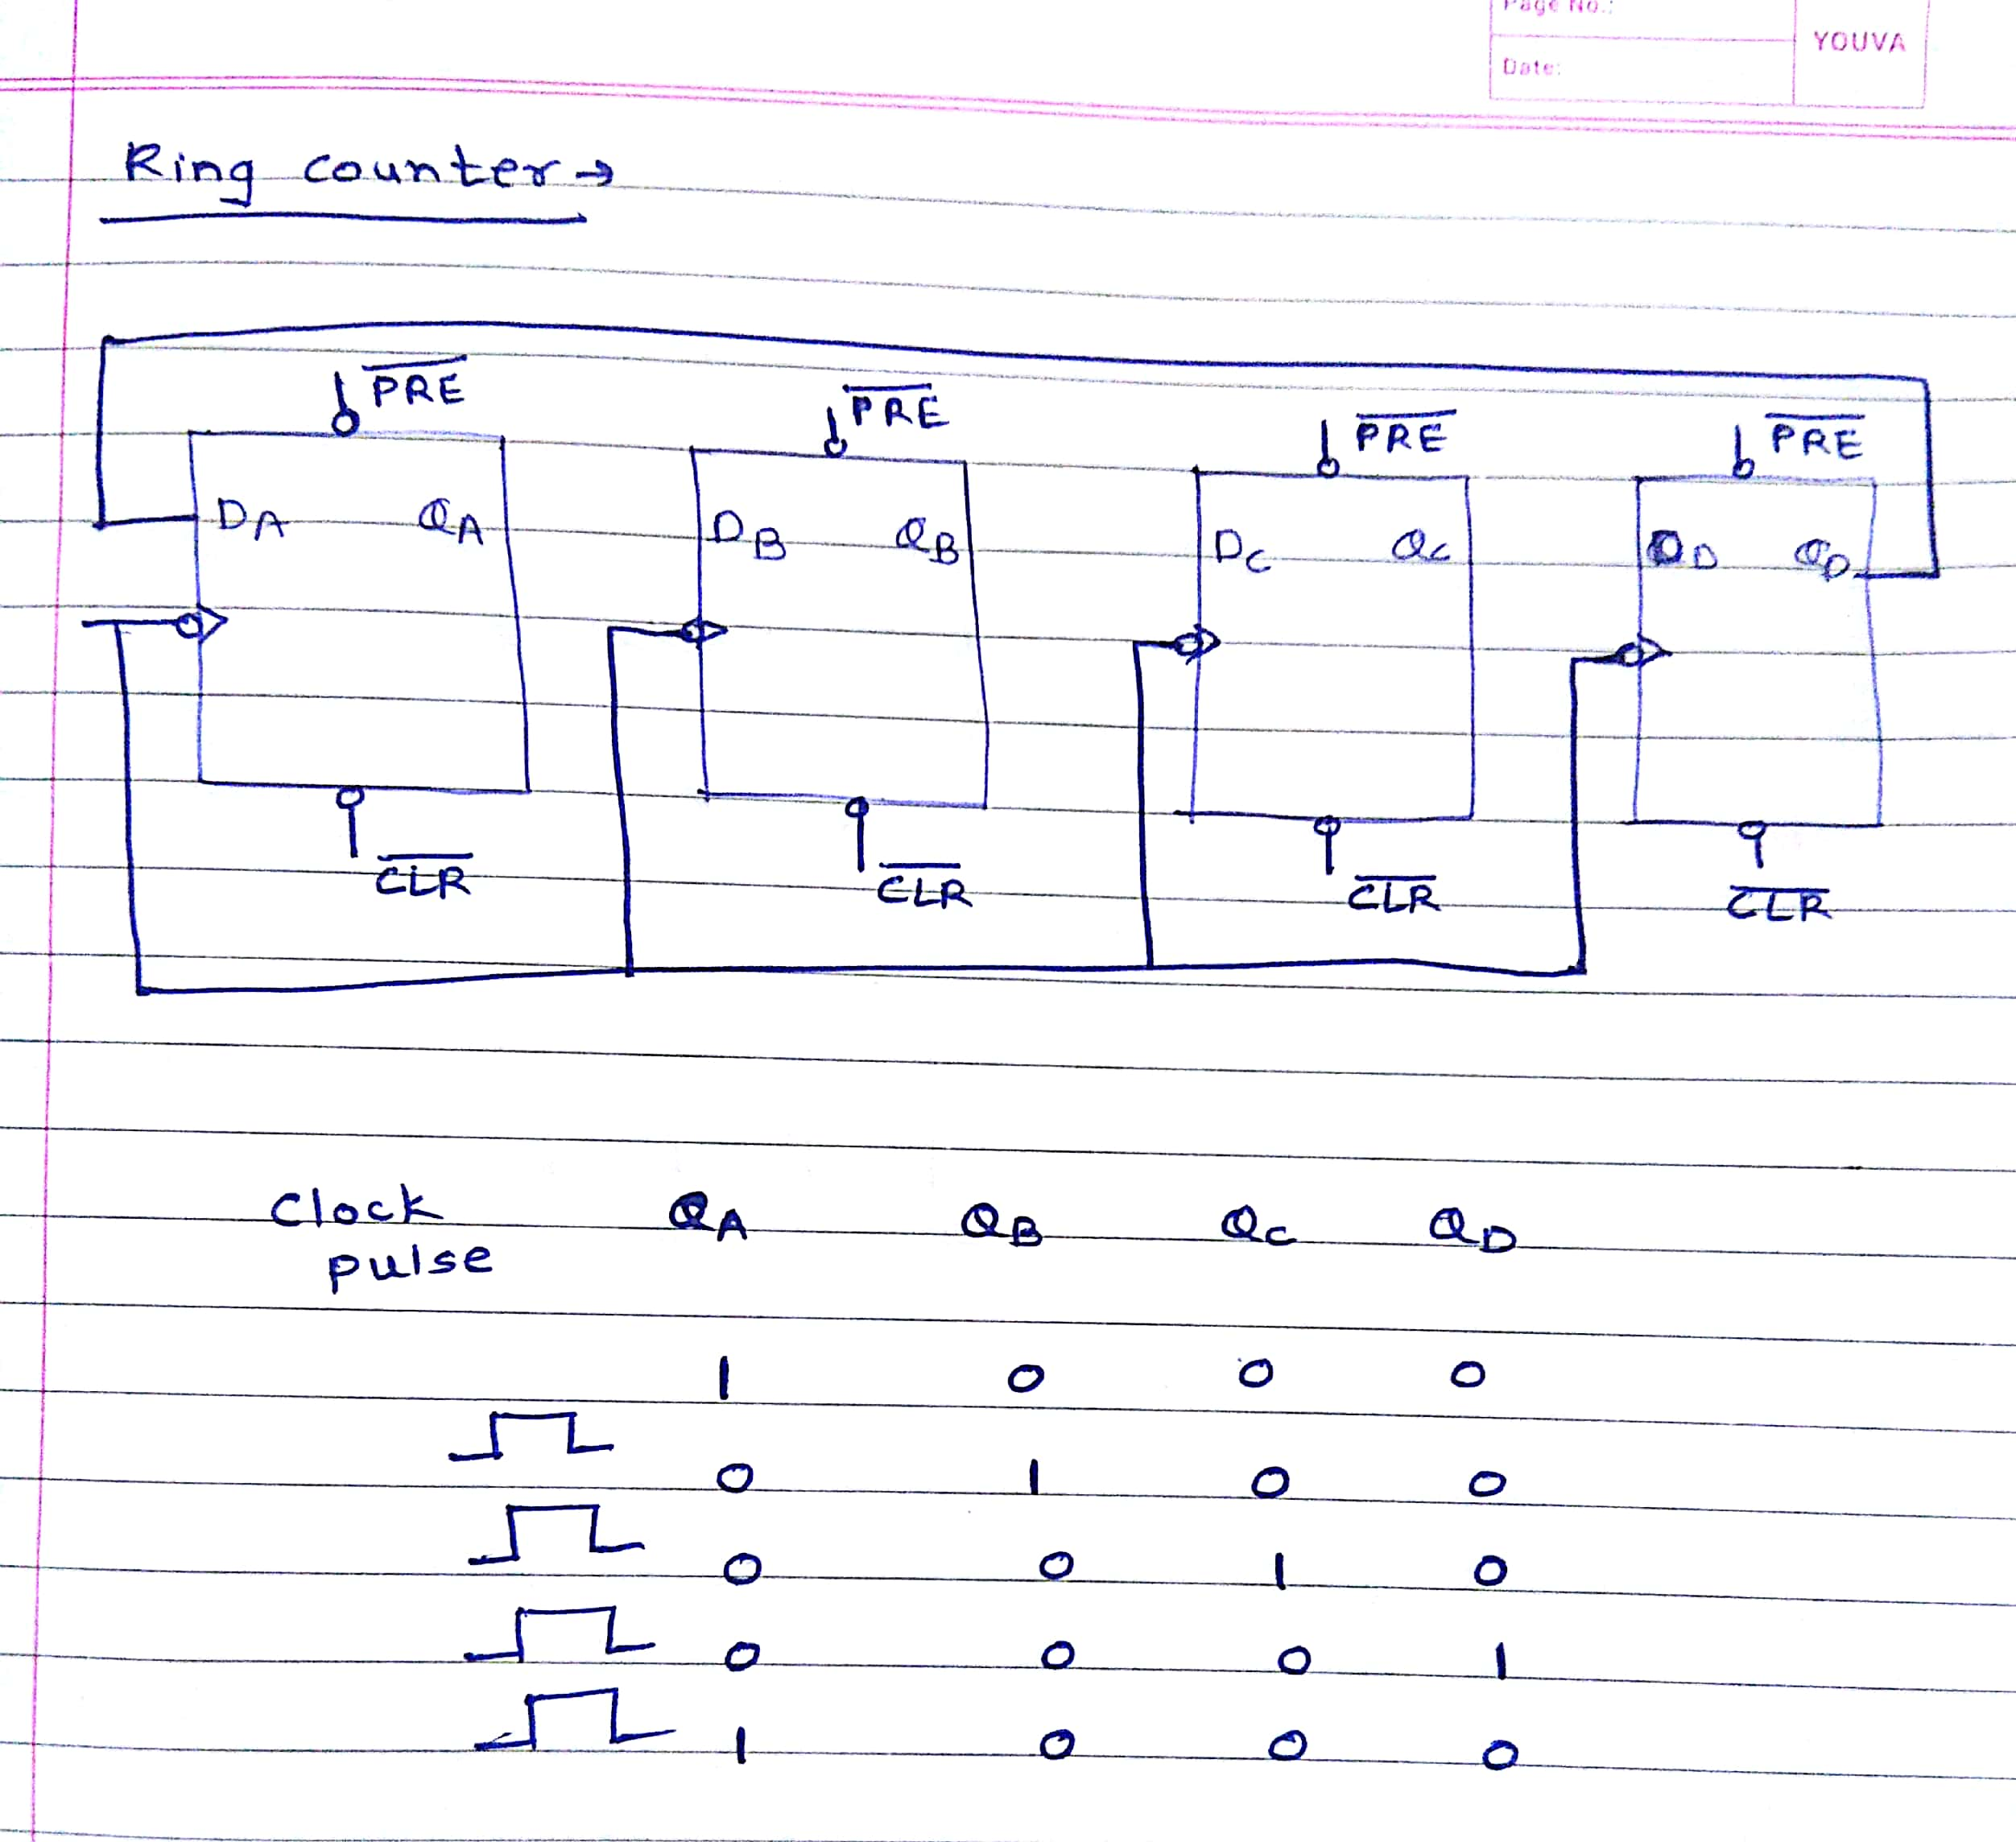

Slide 16
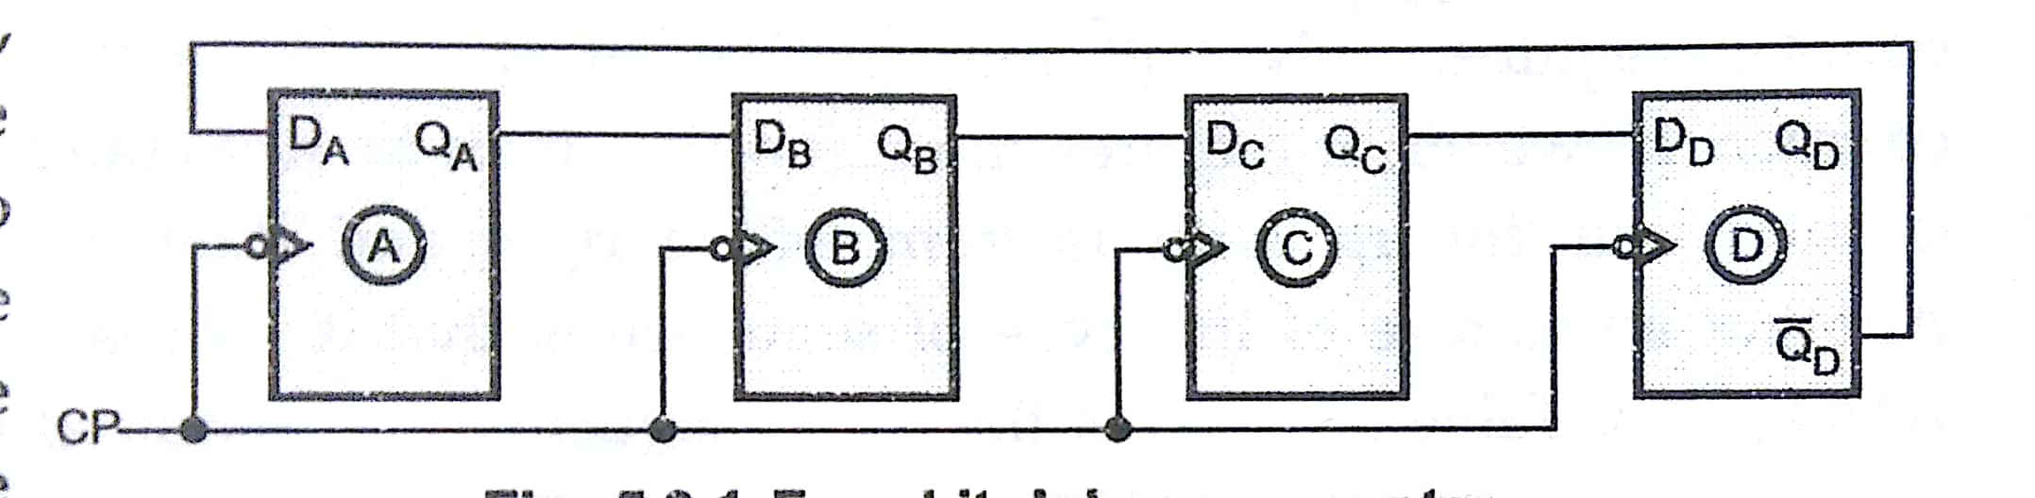
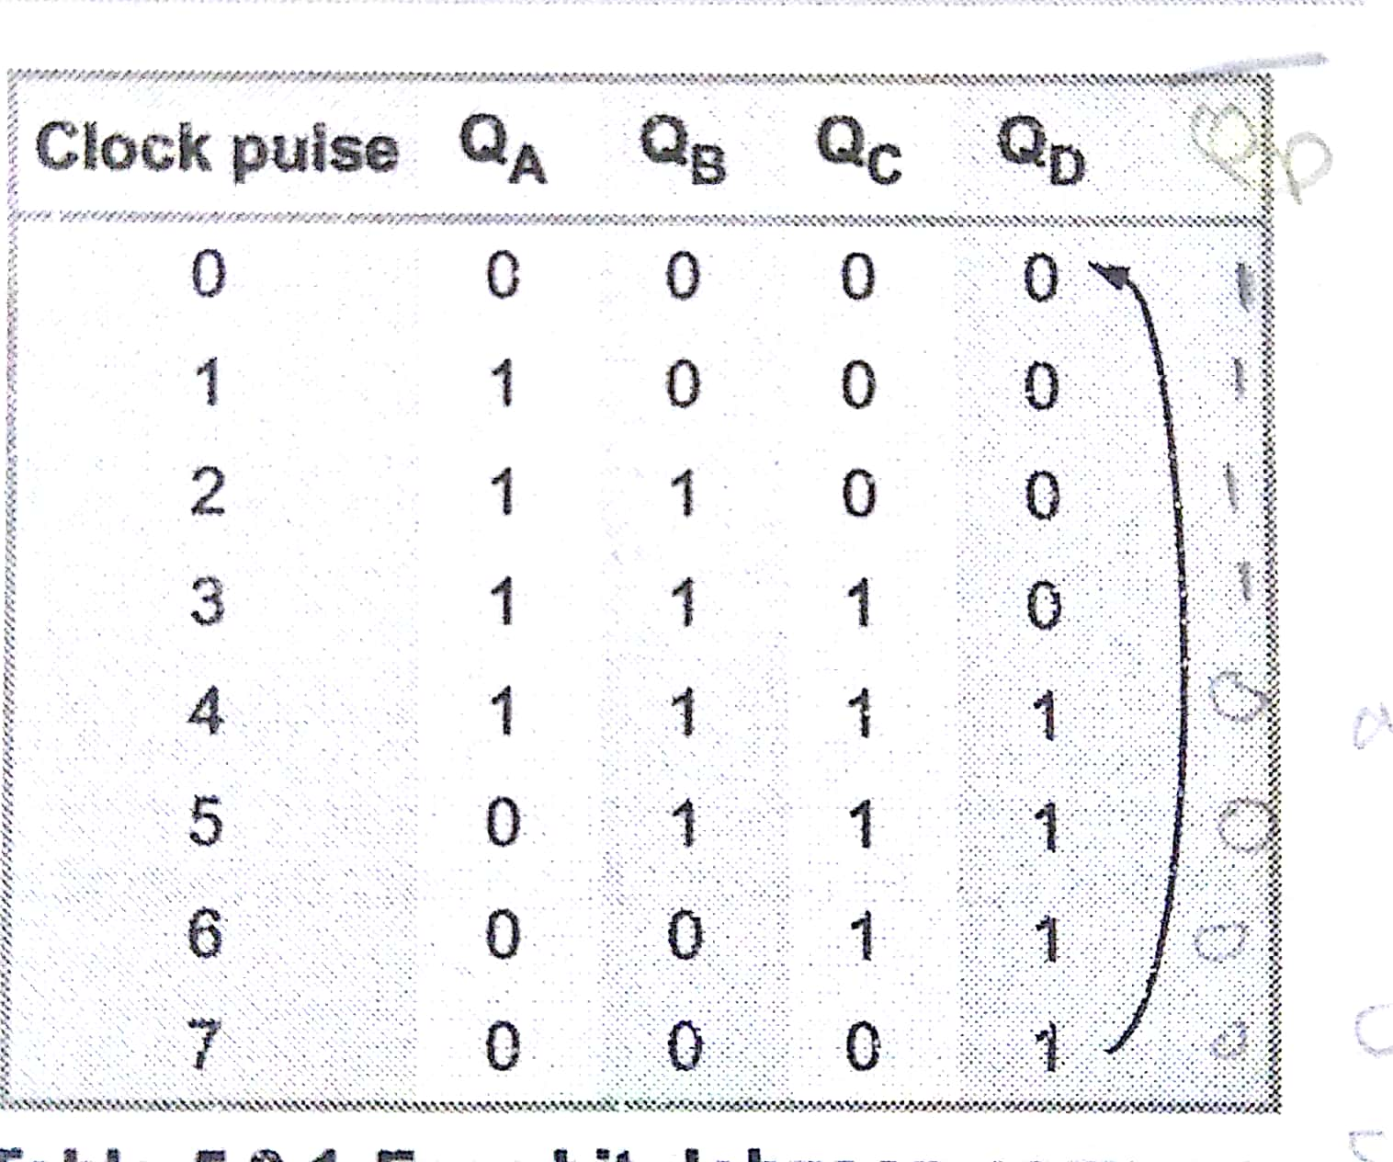
Johnson or Twisting Ring
Counter

Slide 17
Department of Computer Engineering
Thank you

